Slide 1

Cristiano Ronaldo
-Made by Zainab.P (VII-B)

Slide 2

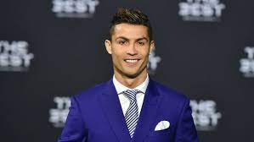
Brief
Often called as the G.O.A.T of modern football, Cristiano Ronaldo dos Santos Aveiro (born 5 February 1985) is a Portuguese professional footballer who plays as a forward for Saudi Professional League club Al Nassr and captains the Portugal national team. Widely regarded as one of the greatest players of all time. He is one of the few players to have made over 1,100 professional career appearances, and has scored over 800 official senior career goals for club and country. He is the only player to score in five FIFA World Cup tournaments..

Slide 3

Table of contents
01
02
03
Brief
Struggles
Achievements
Describing the brief for my topic
The struggles to the path of success.
Achievements achieved till now

Slide 4

02
Struggles of Cristiano

Slide 5
Struggles
Cristiano was a proud but troubled boy, the youngest of four children. His mother was a cook and a cleaner. The family was so poor his mother, Dolores Aveiro, considered terminating her pregnancy and tried a homemade recipe, she revealed in her book Mother Courage. "He told me when he found out, 'Look mum, you wanted to abort me and now I'm the one who's pulling the purse-strings in the house," Dolores later recalled.
Cristiano had trouble controlling his temper and was expelled from school for throwing a chair at a teacher. He assumed he’d become a village fisherman and wasn’t interested in academics. Cristiano was obsessed with football however, and quit school at age 14 to practice full time.

Slide 6
Struggles
His father served in the Portuguese Army and fought two wars in Angola and Mozambique, returning home to unemployment and difficult times although he later found work as a kit man at the local football club where Cristiano played for CF Andorinha. Cristiano joined Clube Desportivo Nacional of Madeira and then Sporting Clube de Portugal before debuting on Sporting's first team in 2002. Even a heart operation at age 15 couldn’t keep him away from the pitch.
"All he wanted to do as a boy was play football," his godfather, Fernao Sousa, told British reporters. "He loved the game so much he'd miss meals or escape out of his bedroom window with a ball when he was supposed to be doing his homework.“
By 18, he’d signed with Manchester United, winning the FA Cup in his first season, then went on to win three consecutive Premier League titles, the Champions League and the FIFA Club World Cup. By age 23, he won his first Ballon d'Or and, at the time, he was involved in the most expensive association football transfer ever when he signed for Real Madrid in 2009 - a transfer worth €94m ($107m). Cristiano eventually ended up back at Man United after his time with Real Madrid and a successful period with Italian giant Juventus.

Slide 7

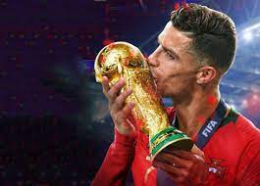
Achievements of Cristiano

Slide 8

1144
Total Games played by Cristiano Ronaldo

Slide 9

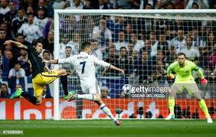
819
266
Total Goals scored by Cristiano Ronaldo
Total assists by Cristiano Ronaldo

Slide 10
6
32
Ballon d'Or
Total Trophies

Slide 11

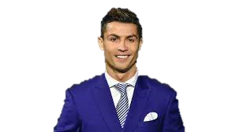
—Cristiano Ronaldo
“If you think you’re perfect already, then you never will be.”

Slide 12
THANK YOU

